Slide 1
Customer Churn Analysis Dashboard

Slide 2
Overview of Customer Churn Analysis
Understanding customer churn is crucial for any business. This analysis examines the drivers of churn, identifies high-risk customer segments, and outlines strategies to reduce customer attrition and improve retention.

Slide 3



Total Customers and Churned Customers
1
Total Customers
6687 customers
2
Churned Customers
1796 customers
3
Churn Rate
26.86%

Slide 4
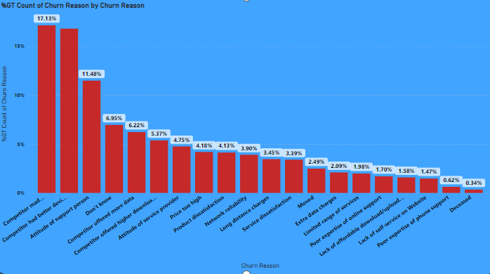
Churn Reasons Analysis
Top Churn Reasons
Competitor made better offer (17.13%)
Competitor had more features (16.79%)
Attitude of support staff (11.48%)
Other Churn Reasons
Don't know (6.95%)
Competitor offered better pricing (6.22%)
Other competitor offers (5.37%)

Slide 5
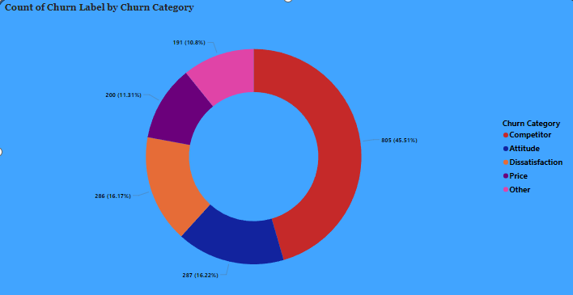
Churn Categories
1
Competitor
805 churned customers
(45.51%)
2
Attitude
287 churned customers
(16.22%)
3
Dissatisfaction
286 churned customers
(16.17%)
4
Price
200 churned customers
(11.31%)
5
Other
191 churned customers (10.8%)

Slide 6
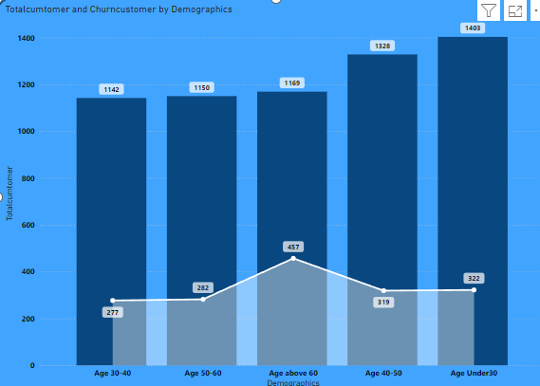
Churn by Demographics
Age Group
Under 30: 1403 total, 282 churned
30-40: 1328 total, 319 churned
40-50: 1169 total, 457 churned
50-60: 1150 total, 322 churned
Above 60: 1142 total, 277 churned

Slide 7
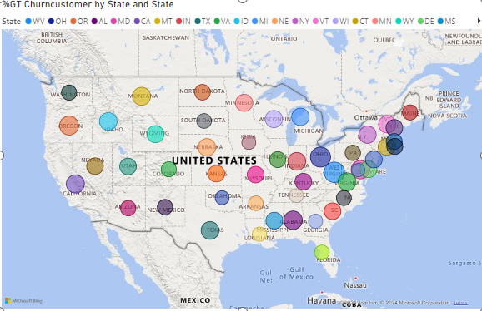
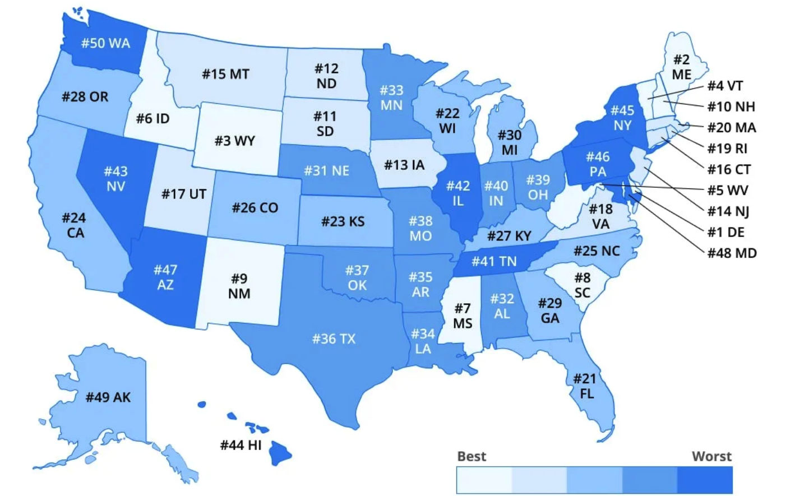
Churn Customers by State
Geographic Churn Insights
The map shows the distribution of churned customers across different states, with higher churn rates seen in states like WV, OH, OR, and AL.

Slide 8
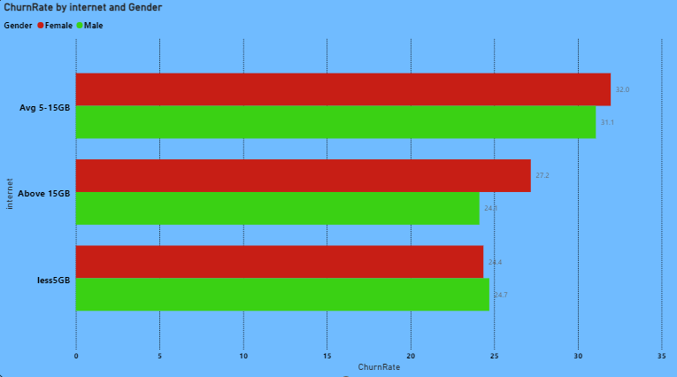
Churn Rate by Internet Usage and Gender
Internet Usage
Less than 5GB: Average churn rate
5-15GB: Slightly higher churn rate
Above 15GB: Highest churn rate
Gender
Female
Male
Prefer not to say

Slide 9
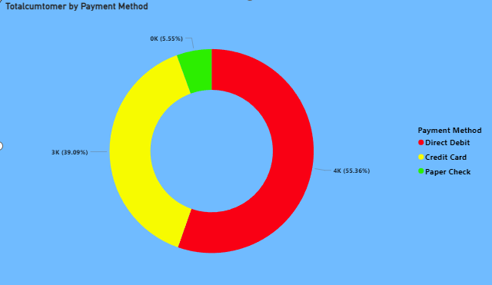
Payment Method Analysis
Direct Debit
55.36% of total customers
Credit Card
39.09% of total customers
Paper Check
5.55% of total customers

Slide 10
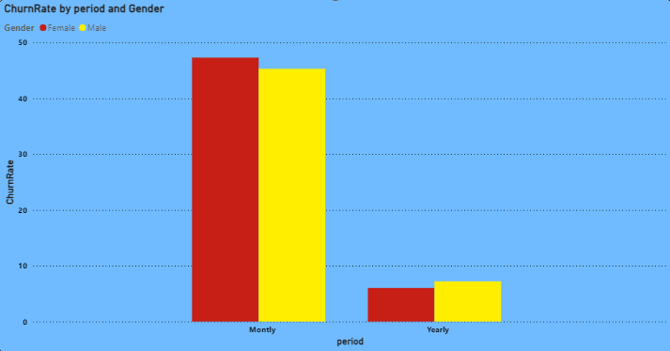
Churn Rate by Subscription Period and Gender
Monthly Subscription
1
Churn rate varies by gender
Yearly Subscription
Churn rate varies by gender
2

Slide 11

Conclusion
The analysis highlights significant insights into customer churn, emphasizing the impact of competitor offers, support staff attitude, and price dissatisfaction. Demographic factors such as age and internet usage also play a crucial role in customer churn. Understanding these metrics can help in devising strategies to reduce churn and improve customer retention.

